Slide 1



Safe Intelligent Transportation In Digital Cities
Scientific Computing Department
Faculty Of Computer And Information Science
Ain Shams University

Slide 2
Team Members
Osama Anter Mohamed Afify
Tarek Ashraf Mahmoud Hussein
Ahmed Mohamed Ibrahim Mohamed
Adham Mohamed Tawfik Mohamed
Ahmed Mohamed Ali Abdelrahman
Under Supervise
Dr. Ayat Mohammed
TA. Marwa Shams

Slide 3
TABLE OF CONTENTS
01
03
02
04
Recap
Models & Results
Recap on the previous seminar
Results of all models used
Dataset Preparation
Web Application
How the dataset is collected and worked on
Building the website and publishing it

Slide 4
Recap
01
Remembering the Road: A Summary of Key Moments

Slide 5
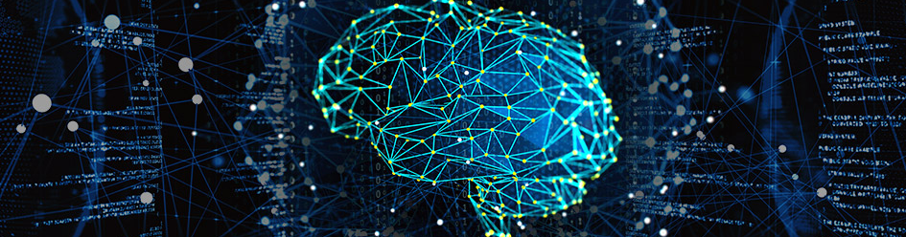
INTRODUCTION
Transportation is a critical sector to any country as it acts as the vessel for all other activities including individuals, enterprises, governmental, and commercial services.

Slide 6
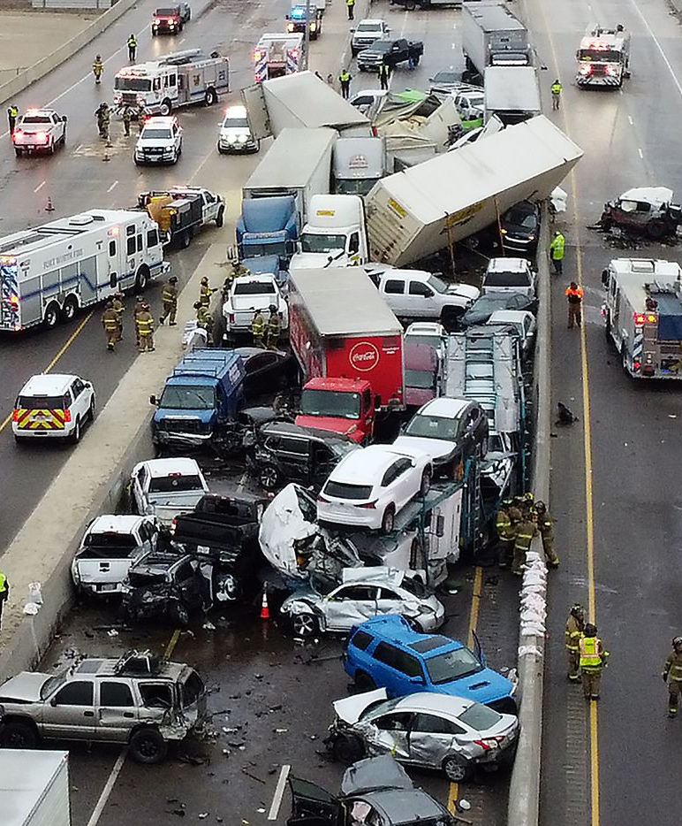
Problem Definition
chain of accidents.
It may cause catastrophes such as explosions.
Time Delay in Requesting The appropriate Service.

Slide 7
OUR VALUES
MOTIVATION
VISION
Drive and Purpose
Creating a Vision: Charting the Path Ahead

Slide 8
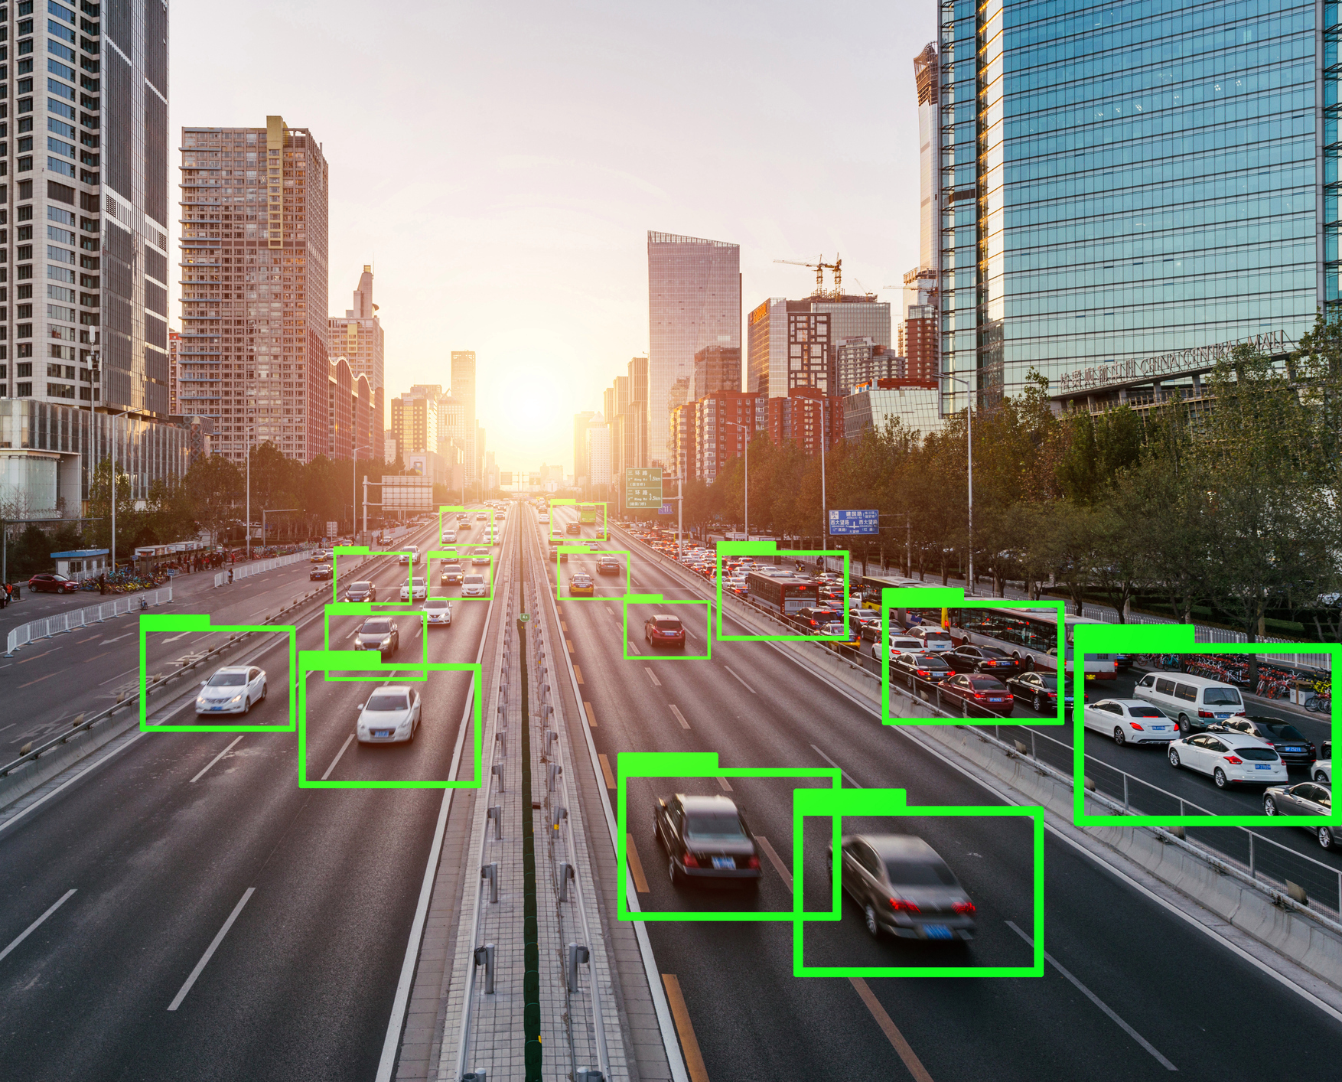
Motivation
When accidents occur on the road, their detection is often delayed saving the situation and this results in many disasters, such as additional accidents or the death of some people, traffic disruption and people's interests, and much more. And Utilizing AI methods and techniques can function computer vision, and optimization to detect, spot, and act on such incidents suggesting the best ways to handle them.

Slide 9
0h 0m 42s
average time difference between two accidents
2,320,637
38,824
Accidents ratio per year
Fatal Car Accident Victims
Reference: https://www.forbes.com/advisor/legal/car-accident-statistics/

Slide 10
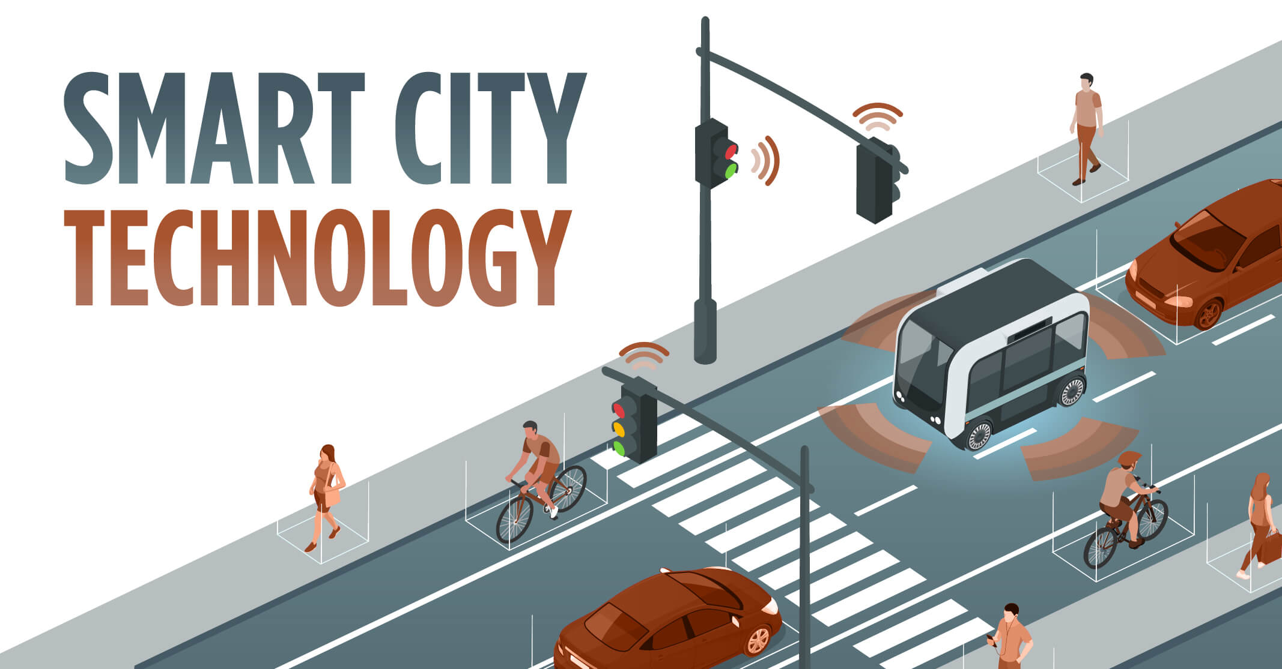
Vision
we can use this technology in smart cities and highway anywhere in the world.
Any kind of accident detected by CCTVs is automatically sent as an alert to the required destination (ex: the nearest traffic units and inform the Civil Protection) to solve the problem as soon as possible and save people's lives and not disrupt the interests of others.

Slide 11
Usefulness
Save people's lives
No traffic densities due to accidents
Finding an alternative to reporting road accidents

Slide 12
Beneficiary
Vehicle Drivers
Transportation Operators
Traffic Authorities
Gov Sectors

Slide 13
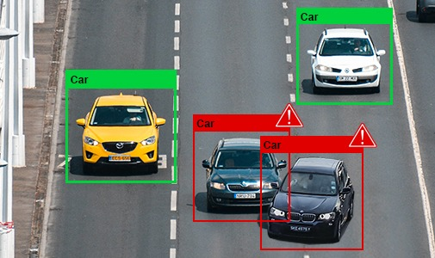
Objective
We want to design a model that can detect accidents using AI methods and techniques that can function computer vision, and optimization to detect, spot, and act on such incidents suggesting the best ways to handle them.

Slide 14
Dataset preparation
02
From Chaos to Structure
Structuring your dataset for success

Slide 15
Dataset preparation
Collecting Images
Images Annotation
Preprocessing and augmentation

Slide 16
Collecting Images
Download Images
Download videos
Using chrome extension “download all images”
Choose relevant videos from youtube
Preprocessing
Generate dataset
Remove irrelevant images from dataset
Upload images and videos to Roboflow

Slide 17
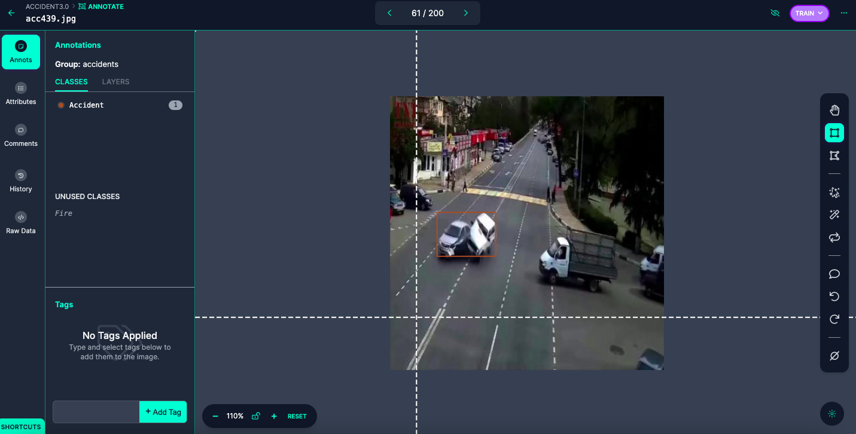
Images Annotation
We tried annotating dataset images using two methods:
labelImg
Roboflow
A python tool used to manually annotate images for object detection
Using the built-in annotating tool in Roboflow

Slide 18
Preprocessing & Augmentation
Resize
Rotation
Blur
Resize the image to 320x320
Rotate 20-30 degree
Smooth the images
Exposure
Noise
Crop
Apply different lights to the images
Apply random noise to the images
Randomly crop the images

Slide 19
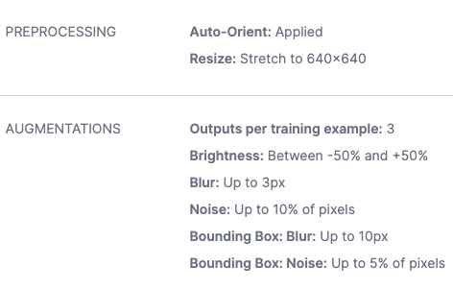
Ex. Of Preprocessing & augmentation

Slide 20
Models & Results
03
Cracking the Code: Unlocking Model Insights and Outcomes

Slide 21
Project progress
Step 1
Step 2
Step 3
Step 4
Dell Dataset
Image Recognition
YOLOv5
YOLOv8
High computation
Low accuracy
Reengaging with object detection
Highest accuracy

Slide 22
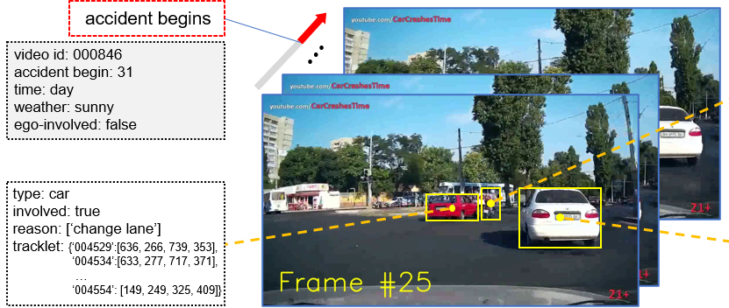
CarCrash
├── codes # useful codes for analyzing
the dataset
├── vgg16_features
│ ├── positive # feature files of positive
(accident) videos
│ │ ├── 000001.npz
│ │ ├── ...
│ │ └── 001500.npz
│ ├── negative # feature files of negative
(normal) videos
│ │ ├── 000001.npz
│ │ ├── ...
│ │ └── 003000.npz
│ ├── train.txt # list file of training split
│ └── test.txt # list file of testing split
├── videos
│ ├── Normal # normal driving videos
│ │ ├── 000001.mp4
│ │ ├── ...
│ │ └── 003000.mp4
│ ├── Crash-1500 # crash accident videos
│ │ ├── 000001.mp4
│ │ ├── ...
│ │ └── 001500.mp4
│ └── Crash-1500.txt # annotation file for
crash accident
└── README.md
Dell Dataset

Slide 23
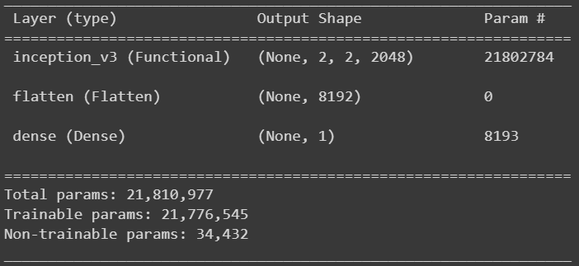
Image Recognintion – Inception
Pre-trained model ➔ ImageNet
Accuracy ➔ varying between 75-85%

Slide 24
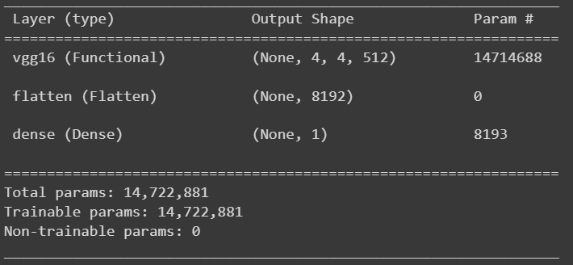
Image Recognition – VGG16
Pre-trained model ➔ ImageNet
Accuracy ➔ varying between 59-68%

Slide 25
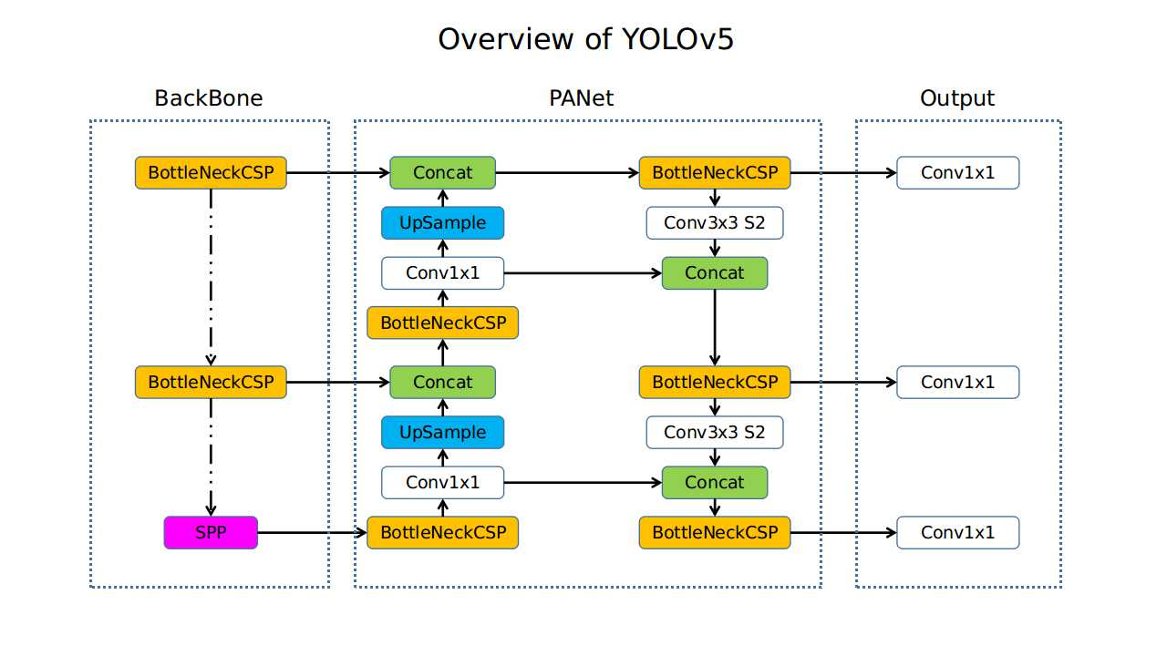
YOLOv5

Slide 26
YOLOv5 Dataset preparation
Collecting images
Generate dataset
Using chrome extension “download all images”
1
3
Upload images with annotation files to google drive
2
Annotating images
Using “labelImg” App

Slide 27
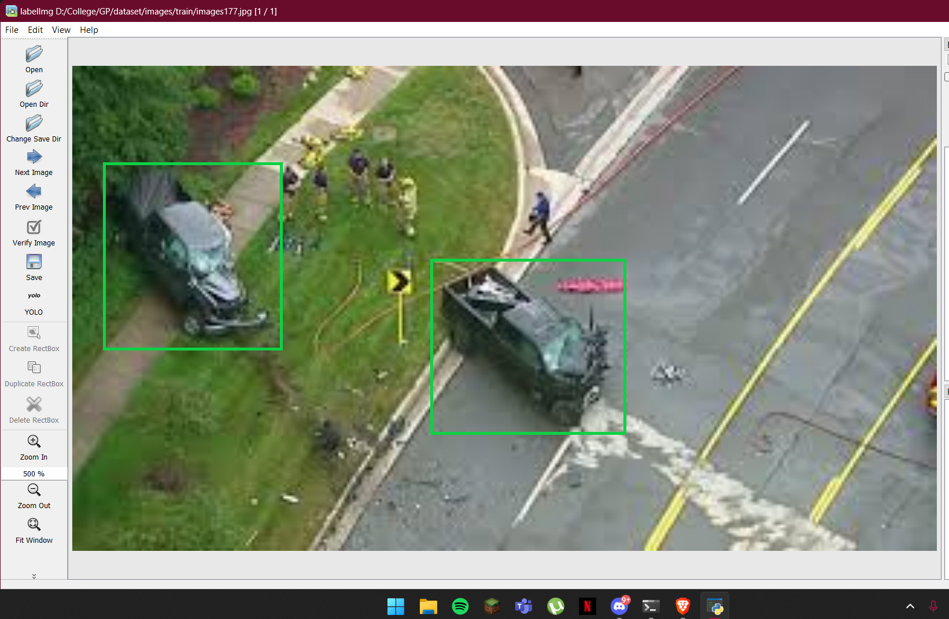
Ex. Of annotating image using labelImg

Slide 28
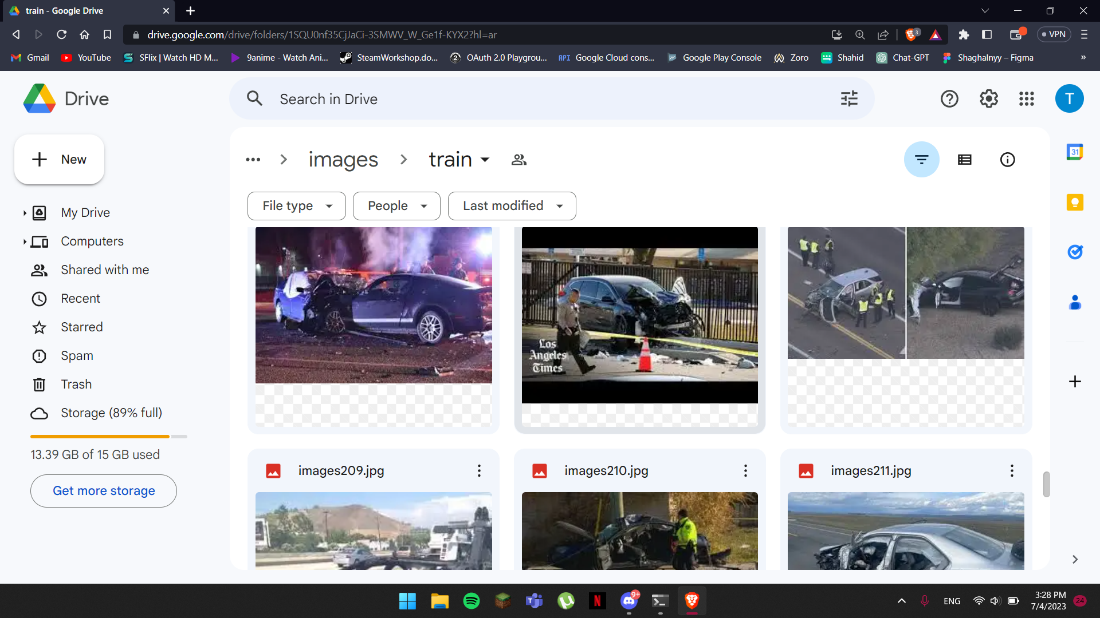
Generate dataset
Upload images
Upload images to google drive
Upload annotation file
Upload annotation files to google drive
Access using colab API
Accessing the dataset using google.colab module

Slide 29
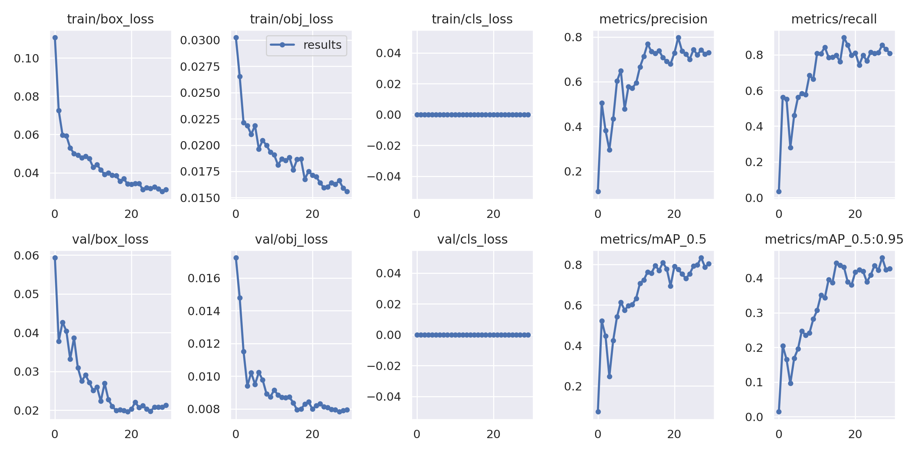
YOLOv5 Results
As shown in the figure we see the evaluation metrics of the experiment

Slide 30
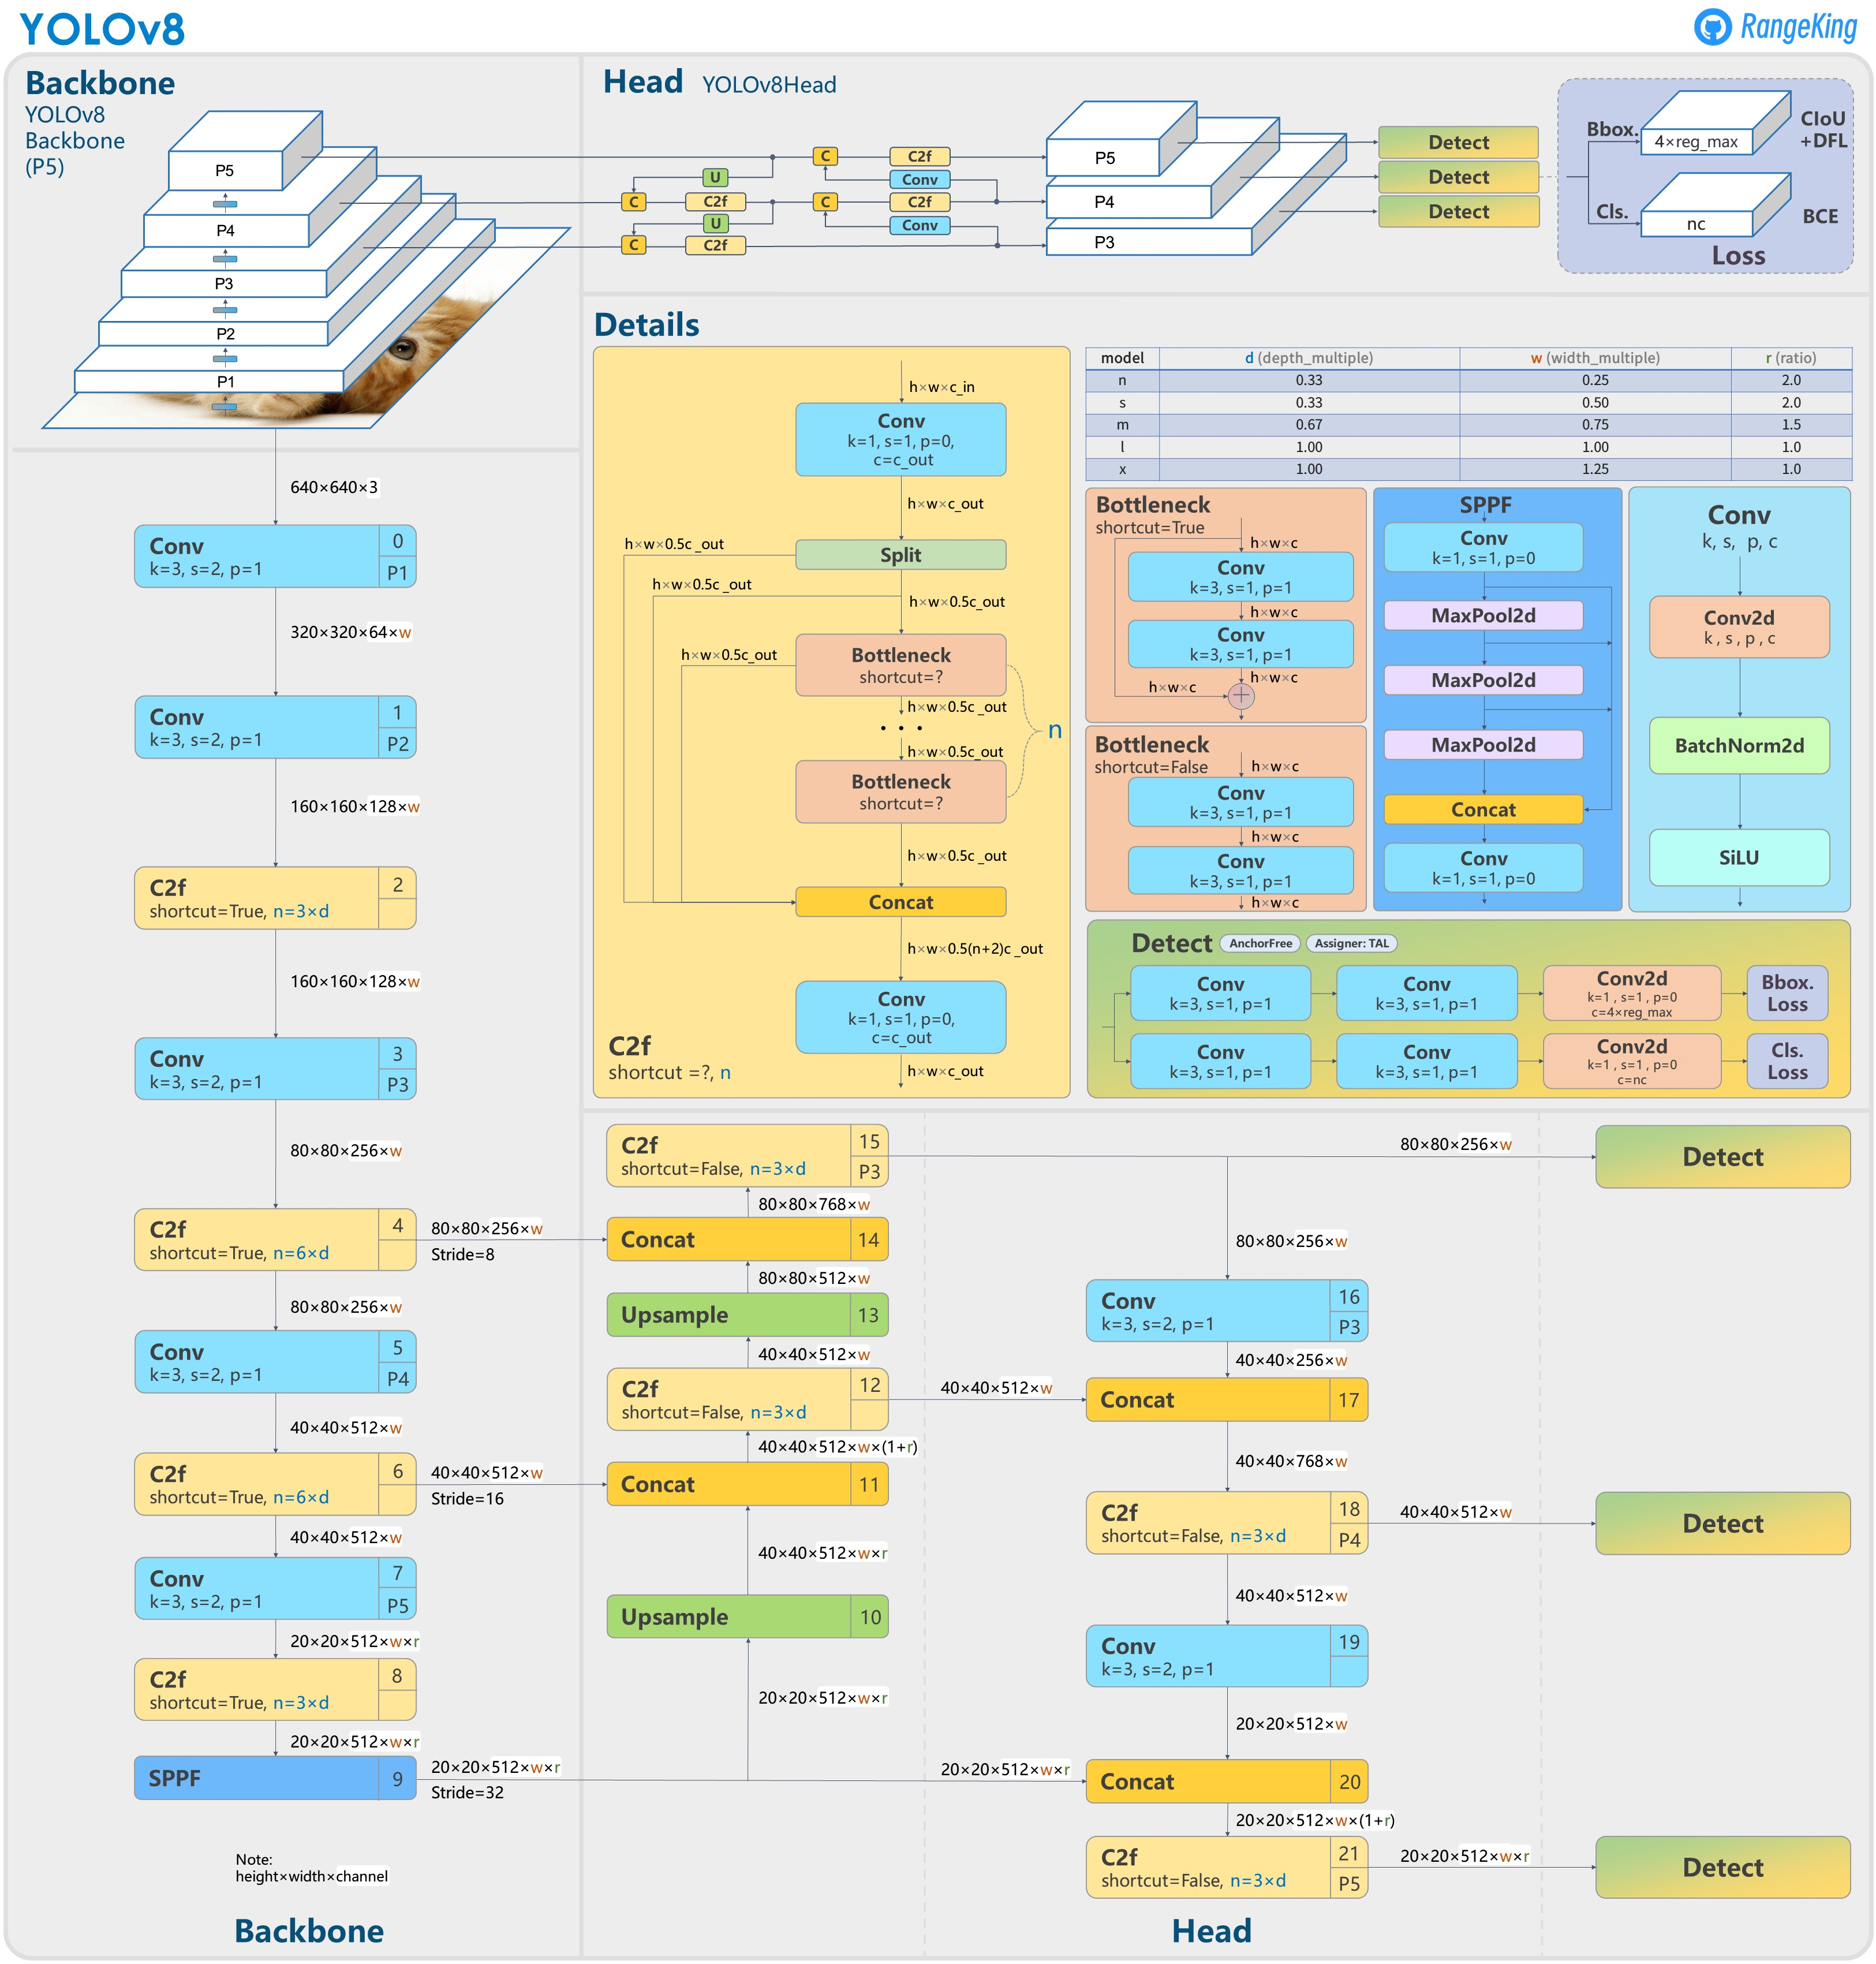
YOLOv8

Slide 31
YOLOv8 Dataset preparation
1
2
3
Collecting images
Upload to Roboflow
Annotate images
Filtering images and videos from YouTube
Upload images using the web interface
Annotate images using built-In tool in Roboflow

Slide 32
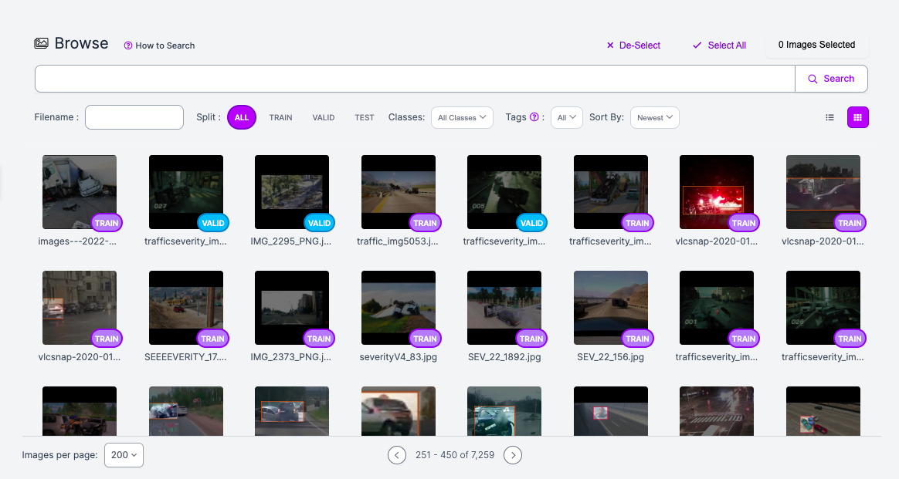
Ex. upload images using the web interface

Slide 33
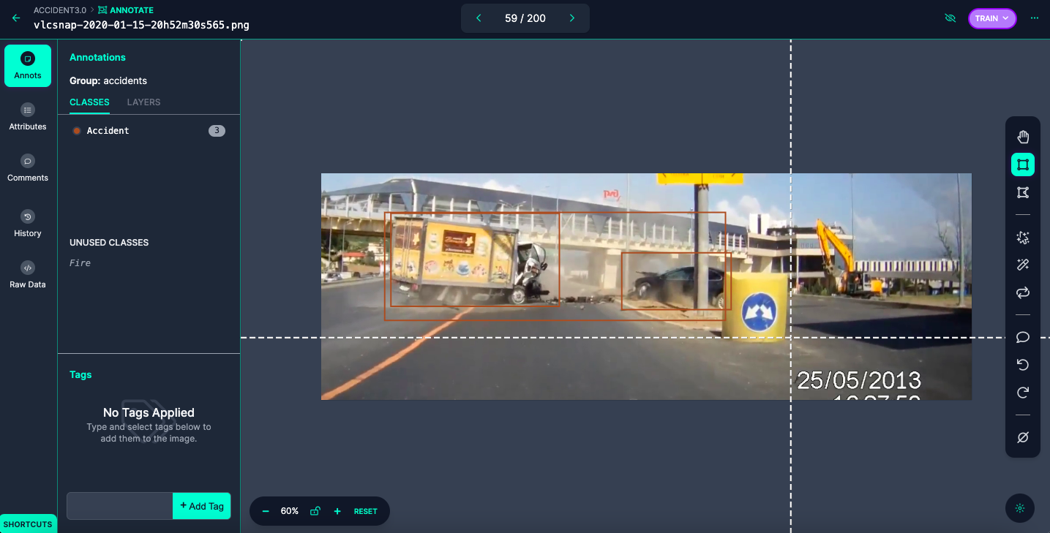
Ex. annotating images

Slide 34
Preprocessing & augmentation
preprocessing
augmentation
1
2
Resize
Auto-orient
Brightness
Blur
Noise
Bounding-box blur
Bounding-box noise

Slide 35
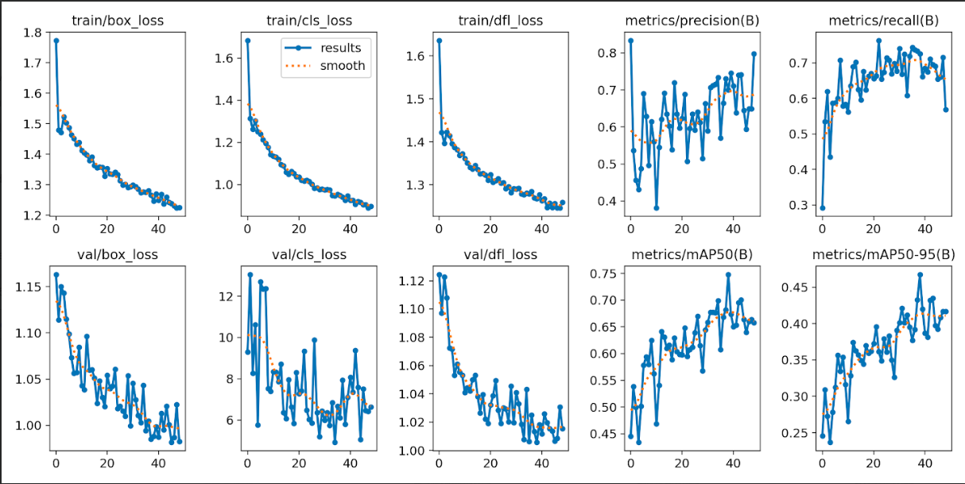
YOLOv8 Results
As shown in the figure we see the evaluation metrics of the experiment

Slide 36
04
Web Application

Slide 37
WEB PROGRESS
1
2
3
4
HTML/CSS
FLASK
ANVIL
STREAMLIT
Used as back-end of the model
To create the landing page
API – Must be running in production
Cannot upload videos

Slide 38

HTML/CSS landpage
A basic landpage website to facilitate user interaction with the model

Slide 39
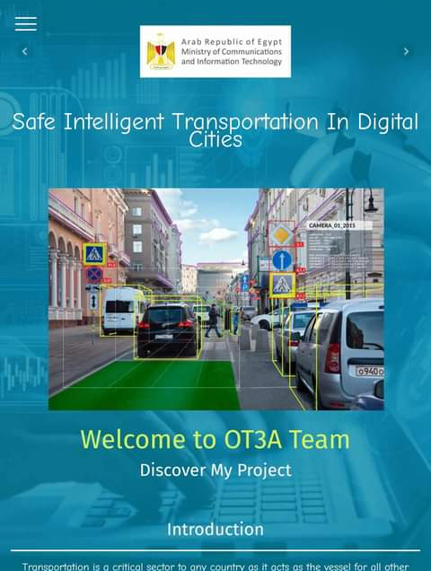
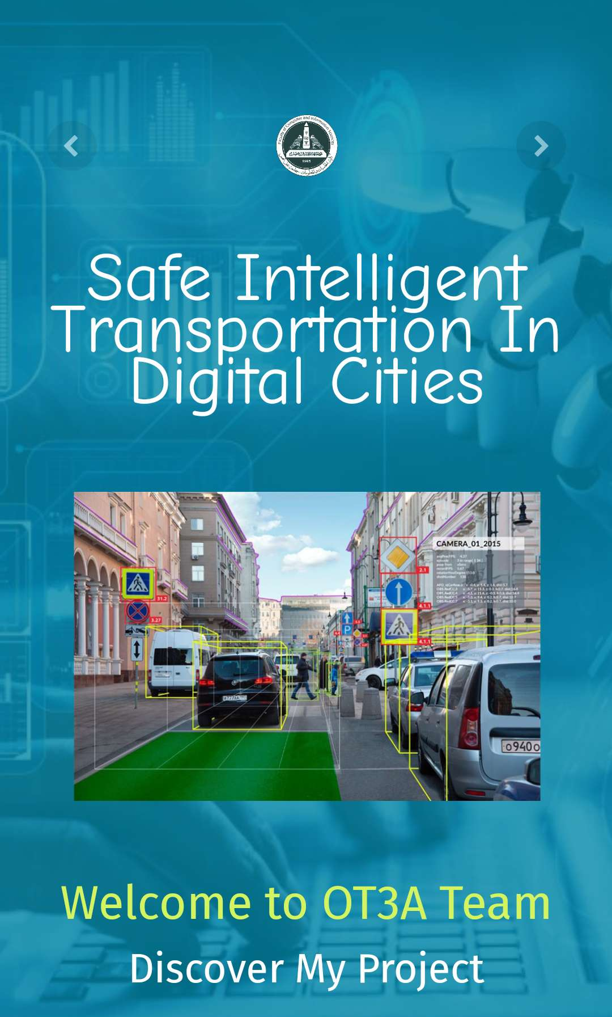
Responsive web-interface

Slide 40

Streamlit process
Developing
Building the web-interface with streamlit module
Uploading
Upload the project to github
Deploying
Connect the repo with the streamlit web app

Slide 41
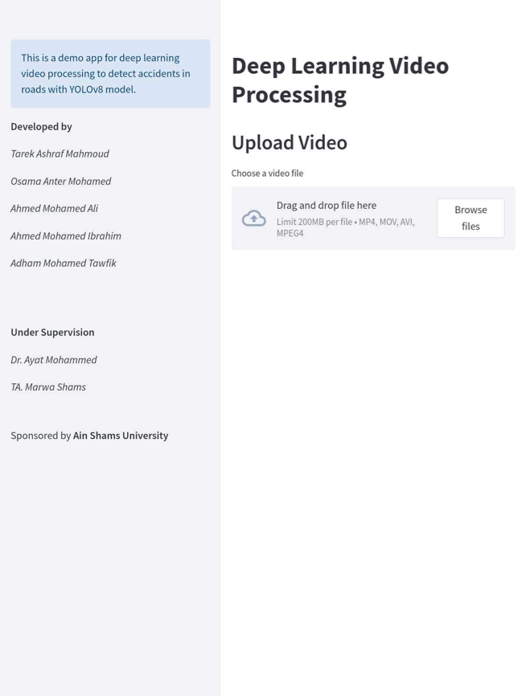
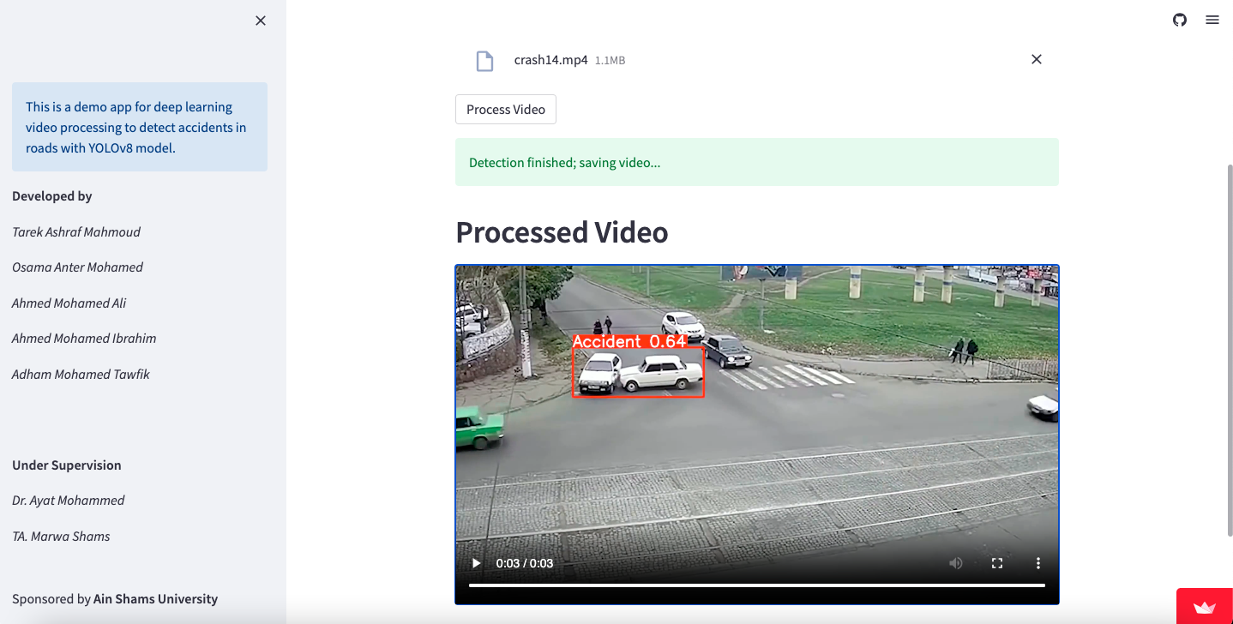
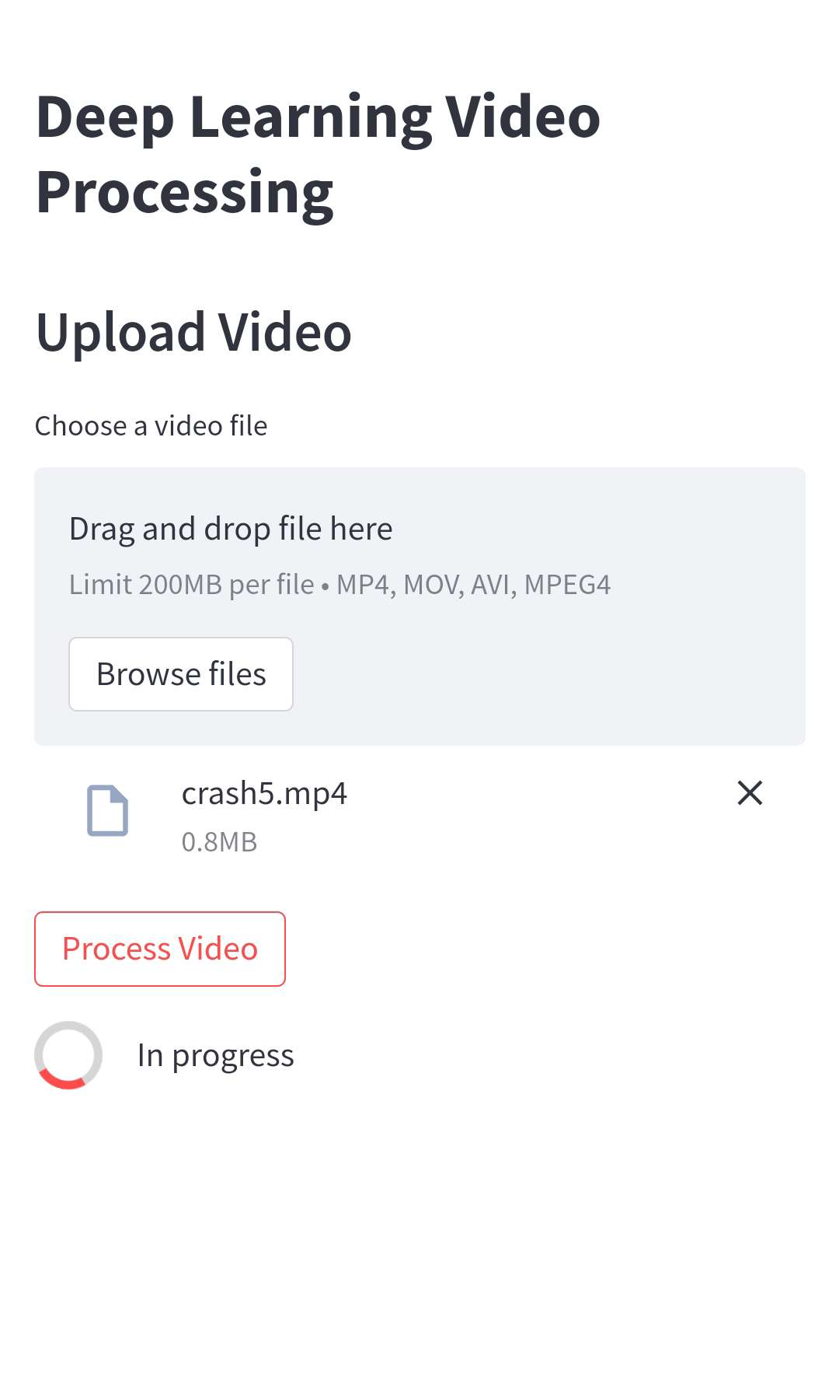
Responsive web-interface using python

Slide 42
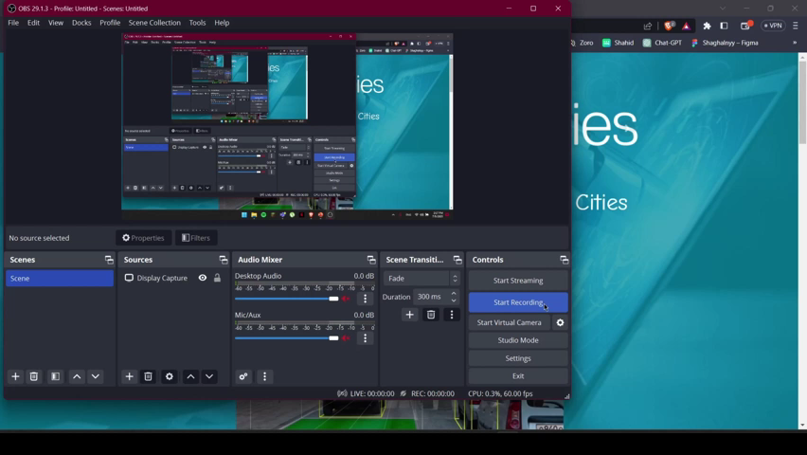
DEMO

Slide 43
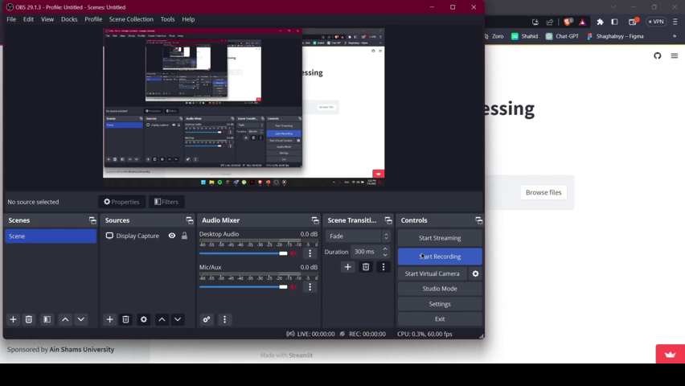
DEMO

Slide 44
Conclusion & future work
Link the model to a traffic network
In case of accidents occurrence, send signals to the corresponding authorities(e.g. police, fire fighting authorities, …etc)
Send the current location and exact time with the SOS signal

Slide 45

Thank you ☺

